Slide 1
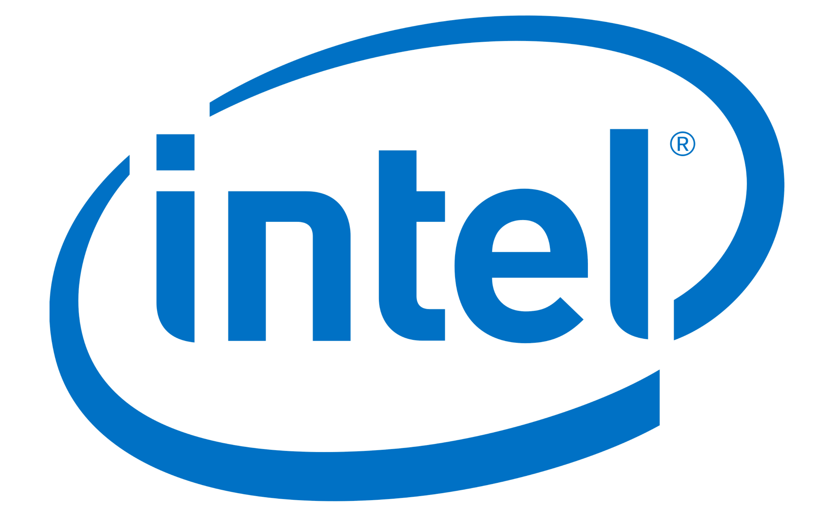
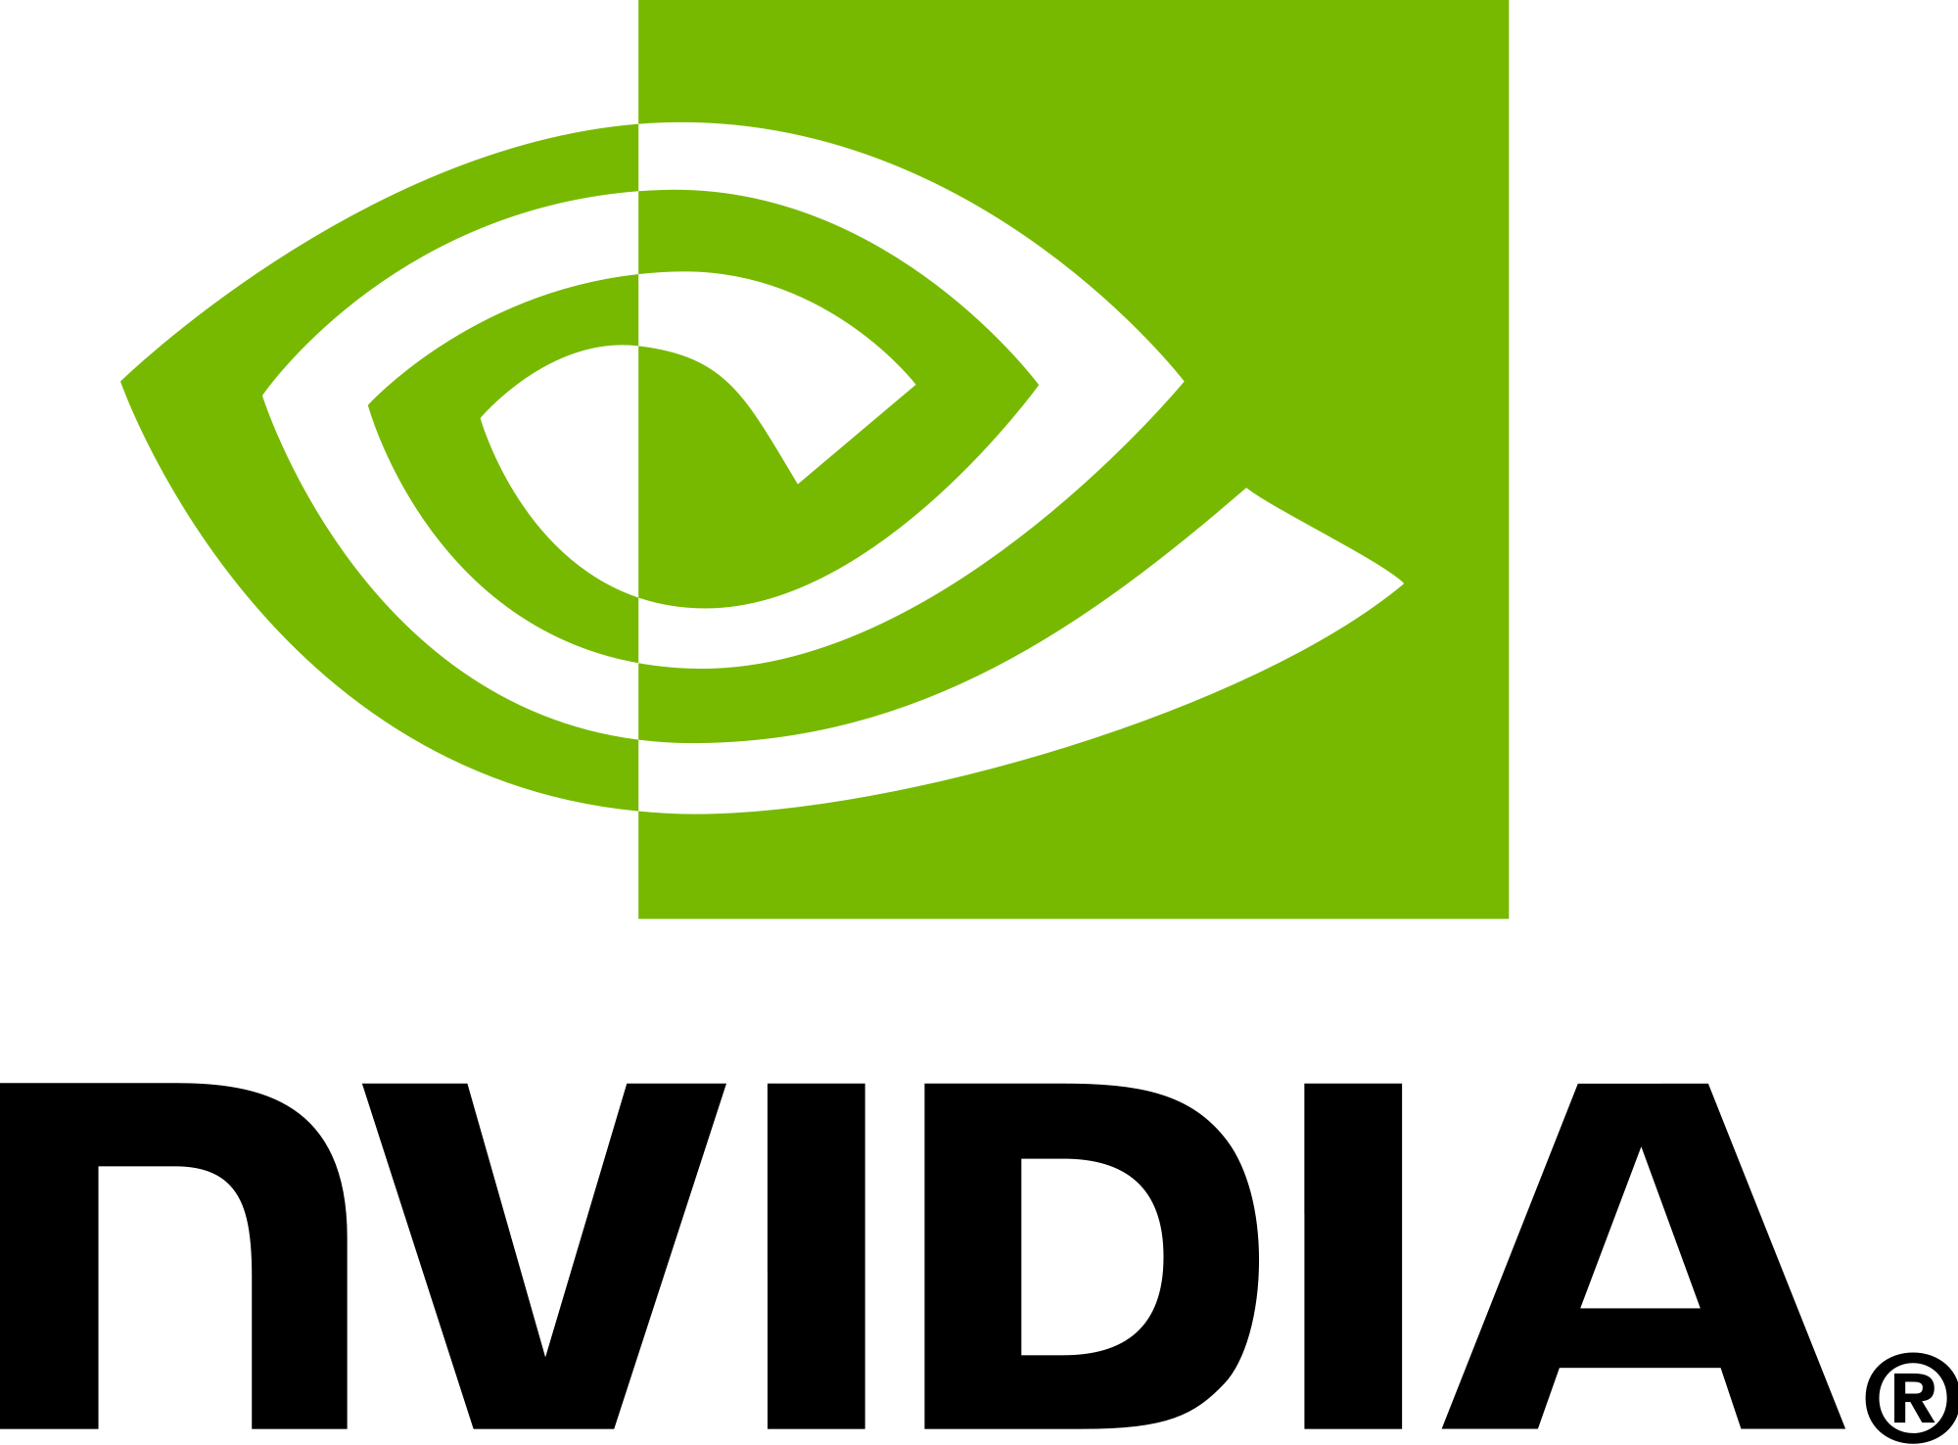

Brand Comparison of Amd, Intel, and Nvidea Through Twitter
By Truett Bloxsom

Slide 2
Road Map
1) Data Sources and Preprocessing
2) Lift Analysis of Brands
3) Lift Analysis of Major Attributes of Brands
4) Sentiment Analysis
5) Summary and Results

Slide 3
Data Sources and Preprocessing
Scraped ~16,000 tweets from twitter using key word search and python
Key words included: CPU, GPU, processors, PC, and APU
Time range spanned from 2007 to 2020 with over ~10,000 being from past week
Preprocessing included: tokenization, lemmatization, and removing stop-words/punctuation using the nltk python package

Slide 4
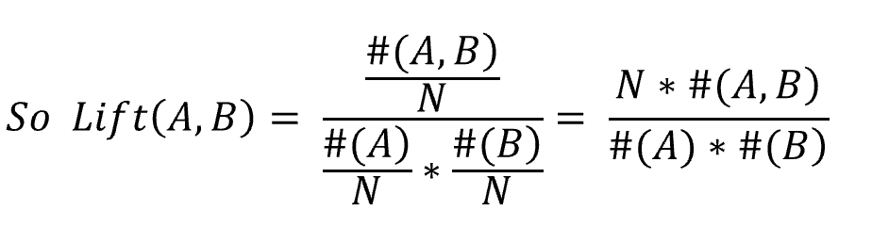
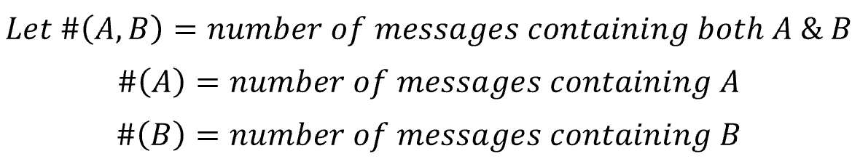
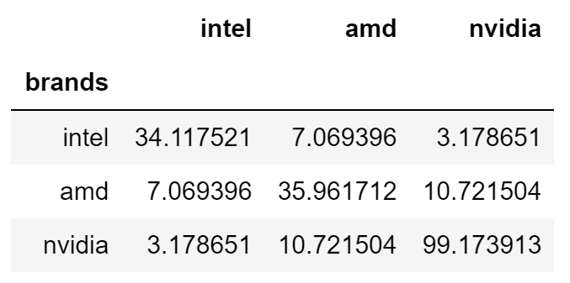
Lift (association) Ratio between brands
A lift > 1 means there is an association
Lift > 10 means the two words are synonymous
AMD is synonymous with NVIDEA and AMD is more associated with Intel than Intel is with NVIDEA

Slide 5
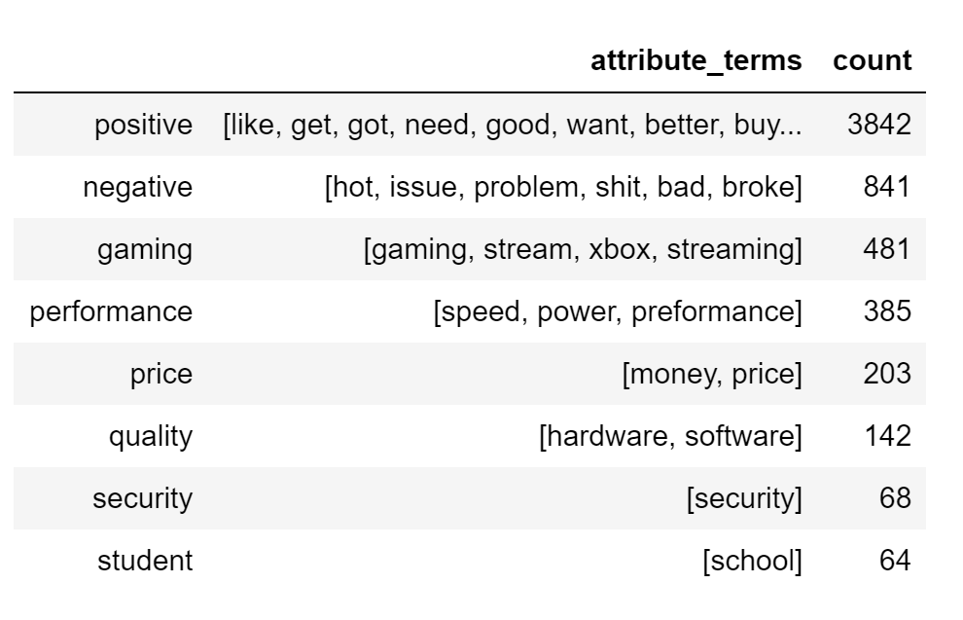
Comparing Attributes for Brands using Lift
Table shows which words (attribute_terms) were used to create an overall attribute (gaming, price etc.)
Each brand has a lift score for each overall attribute
Keep in mind that larger samples will be more robust
If the lift score is zero, that means that there was no tweets that included the brand name and any attribute_term

Slide 6
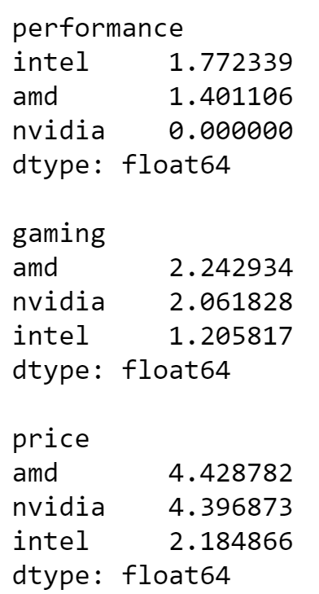
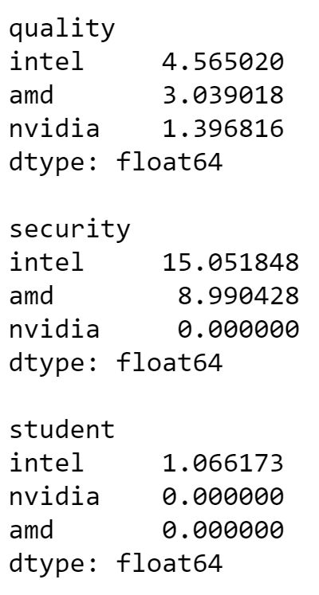
Comparing Attributes for Brands using Lift
Intel scores better in performance
AMD and NVIDEA out score Intel in price
Both Intel and AMD score well in quality
Intel is synonymous with security but AMD scores high

Slide 7
Sentiment (emotion) Analysis of Brands
Sentiment Analysis is simply the process of working out (statistically) whether a piece of text is positive, negative or neutral.
Each of the words in the lexicon (vocabulary) is rated as to whether it is positive or negative, and in many cases, how positive or negative
So for each overall attribute, each Brand will have a positive or negative score
Notes:
Source: http://t-redactyl.io/blog/2017/04/using-vader-to-handle-sentiment-analysis-with-social-media-text.html

Slide 8
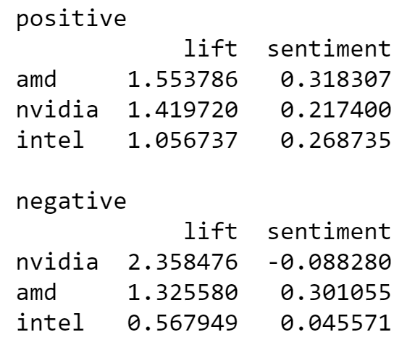
Sentiment (emotion) Analysis if Brands
AMD had highest lift with positive words and strongest seintiment
NVIDEA had strongest lift with negative words
AMD has significant lift with negative words but has positive sentiment
Intel products are considered “neutral”

Slide 9
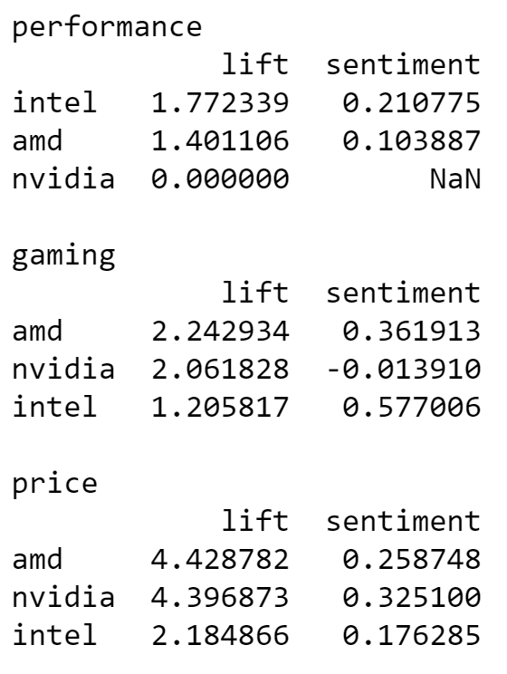
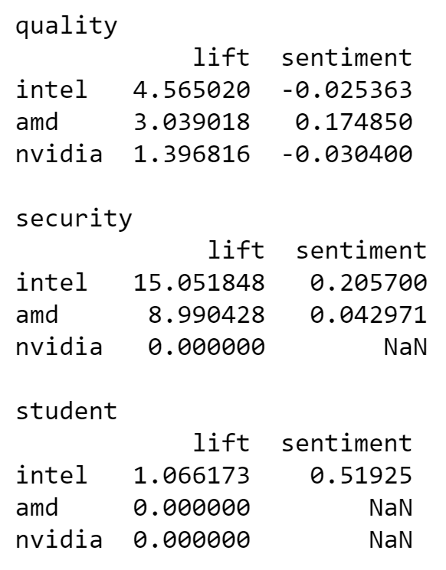
Sentiment (emotion) Analysis if Brands
Intel has more positive sentiment when it comes to performance
AMD has significant positive sentiment with gaming compared to NVIDEA
AMD has positive sentiment concerning quality where intel has slightly negative
Intel is seen as the student option

Slide 10
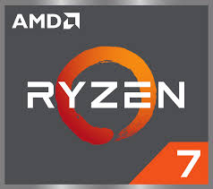
Results and recommendations
Intel’s performance and security attributes are seen as more favorable than AMDs
But in almost all other attributes (gaming, price, and quality) AMDs products are more favorable
RECOMMENDATIONS:
1) Market AMD’s Ryzen processors as out competing Intel’s in both price and quality
2) Promote difference between AMD and NVIDEA since NVIDEA has poor sentiment regarding multiple attributes

Slide 11
Potential Future Analysis
Add products of the brands and compare products
Add more overall attributes
Add more brands like Qualcomm and Synopsys
Subset attributes by market i.e. Asia, Europe, US
This further analysis will require much more data and from more sources other than twitter

